Slide 1
Citation Provenance
FYP Presentation
Heng Low Wee
19 Nov 2012

Slide 2
Citations in research papers give credit and uphold intellectual property
Citations refer to cited document for information

Slide 3
Problem?

Slide 4
Example
“…been based on generative models that are closely related to probabilistic contextfree grammars. Recently, classifier-based dependency parsing (Nivre and Scholz, 2004; Yamada and Matsumoto, 2003) has showed that deterministic parsers are capable of high levels of accuracy, despite great simplicity. This wo…”

Slide 5
Example
“…the measure of sense similarity. Lexical Chains Lexical cohesion is often represented via lexical chains, i.e., sequences of related words spanning a topical text unit (Morris and Hirst, 1991). Algorithms for computing lexical chains often perform WSD before inferring which words are semantically relat…”

Slide 6
Example
“…number of Italian documents available on Internet is much smaller than for English and Spanish: Estimates reported in (Kilgarriff and Grefenstette, 2003) show that for Italian the web size in words in 1,845,026,000; while for English and Spanish the web size are 76,598,718,000 and 2,658,631,000 respectively. Thus our method was not able to extract as much information as for the other two languages.”
Notes:
----- Meeting Notes (18/11/12 20:27) -----
What is common among the 3, is there is no indication of where the cited information is in the cited paper

Slide 7
Problem
Most citations are mere mentions
Even if referring to claims specifically, it is not immediately clear where is this information in the cited document

Slide 8
Cited
Cited
Citing
Cited
Cited

Slide 9
Cited
Cited
Citing
Cited
Cited

Slide 10
Cite
Cite
Cite
Cite
Citing
Cited

Slide 11
Cite
Cite
Cite
Cite
Citing
Cited

Slide 12
Cite
Citing
Cited

Slide 13
?
Cite
Citing
Cited

Slide 14
What is Citation Provenance?

Slide 15
Task: To locate the information in the cited paper that justifies the citation

Slide 16
Aim: To identify which section or paragraph in the cited paper is the cited information

Slide 17
Outline
Introduction
Related Work
Problem Analysis
Approach
Evaluation
Discussion & Conclusion

Slide 18
Related Work

Slide 19
Related Work - Overview
Citation-related tasks require extracting features from citing sentence/context
There is demand for a reading tool that answers readers’ doubt – where is the origin of the citation?
A need to handle paraphrasing that is common when making citations

Slide 20
Citation Classification
To classify citations into pre-defined classes so as to determine the rationale for citing
12-class annotation scheme [Teufel et al, 2009]
Weak (1), Compare & Contrast (4, E.g. CoCoXY), Positive (6, E.g. PUse), Neutral (1)
Citances (Citing sentence) [Nakov et al, 2004]
Automatic citation classification
Features from citances
Cue words/phrases
Notes:
----- Meeting Notes (18/11/12 20:36) -----
12-class: to define what the cited paper is cited for

Slide 21
Content-Sensitive In-Browser Summariser (CSIBS)
Conducted series of survey
Difficult to find exact text that justifies citation
Citation does not include position of origin
Summarisation tool
Displays preview of cited document; Highlight content-sensitive keywords
<Demo page>

Slide 22
Sentence Alignment / Paraphrase
Nelken & Sheiber, 2006 presented a novel algorithm that produced great precision at aligning sentences in monolingual corpora
Shinyama et al., 2002 worked on automatic paraphrase extraction from news article

Slide 23
Outline
Introduction
Related Work
Problem Analysis
Approach
Evaluation
Discussion & Conclusion

Slide 24
Terminology

Slide 25
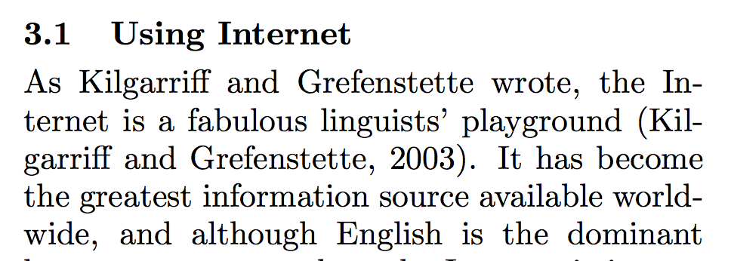
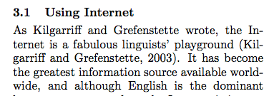
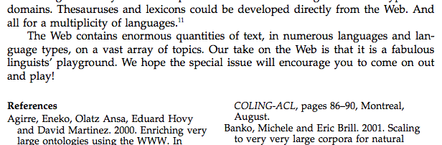
Citing
Cited

Slide 26
Citing
Cite Link: [PaperA]==>[PaperB]
Cited

Slide 27
Citing
Cite String
Cite Link: C04-1201==>J03-3001
Cited

Slide 28
Citing Sentence
Citing
Cite String
Cite Link: C04-1201==>J03-3001
Cited

Slide 29
Citing Sentence
Citing
Cite String
Citing Context
Cite Link: C04-1201==>J03-3001
Cited

Slide 30
Citing Sentence
Citing
Cite String
Citing Context
Cite Link: C04-1201==>J03-3001
Cited
Cited Fragment

Slide 31
Problem Analysis

Slide 32
Is the citation a mere mention?
What is a mention? What is not?
How to tell whether it is just a mention or not?
If it is referring to specific information, how do we locate it in the cited paper?

Slide 33
General vs Specific

Slide 34
General Citations
Authors may refer to paper…
…as a whole. If author cites for a key idea, e.g. Machine Learning, and this idea makes up the entire paper
…just to mention it. Give credit; acknowledgement

Slide 35
Specific Citations
Authors may refer to paper…
…for term definitions
…for key idea/implementation. It does not make up the entire paper
…for algorithm/theorem. It does not make up the entire paper
…for digits/numerical figures. E.g. refer to evaluation results. To complement performance
*Applicable for our corpus only
Notes:
This observations apply for the corpus we are working with

Slide 36
Scope of the Problem
CitProv is Abstract
End
General
Second tier
G/S
Use some ranking system to find region
CitProv is that region
Start
Specific
CitProv is some region
End
First tier

Slide 37
Scope of the Problem
How about locating in-line citations?
ParsCit [Councill et al., 2008]
Open-source
Citation parsing / citation extraction
Logical structure parsing of scientific documents
Abstract away the problem of locating in-line citations
Focus on citation provenance

Slide 38
Modeling Our Problem - Search
:
Candidate 1
Candidate 2
Query
Candidate
Candidate i
:
Candidate m
Citing Paper
Cited Paper

Slide 39
Target Corpus
ACL-Anthology Reference Corpus (ACL-ARC)
Computational Linguistic papers
Interlink data
E.g. [PaperA]==>[PaperB]
Just a start; Aim to eventually generalize to all fields of research

Slide 40
What data do we need from corpus?

Slide 41
Cited
Cited
Citing
[PaperA]==>[PaperB]
Cited
Cited
Notes:
----- Meeting Notes (18/11/12 20:50) -----
Which paper cites which paper?

Slide 42
Cite
Cite
Cite
Cite
Citing
Cited
Notes:
----- Meeting Notes (18/11/12 20:50) -----
Where are the in-line citations?
We use ParsCit

Slide 43
Cite
Cite
Cite
Cite
Citing
Cited

Slide 44
Cite
Citing
Cited
Notes:
----- Meeting Notes (18/11/12 20:50) -----
We need to know where is the cited information
We also need to know where this citation is pointing to in the cited paper

Slide 45
?
Cite
Citing
Cited

Slide 46
What data do we need?
Instance | Cite Link | Context | Fragment | Citation Provenance
: | : | : | : | :
3050 | X98-1031==> X96-1049 | …Penn Treebank 3 release (Marcus et al., 1993), the string in (1) is a variation… | …POS tagging phase is automatically parsed an… | ?
3051 | X98-1031==> X96-1049 | …Penn Treebank 3 release (Marcus et al., 1993), the string in (1) is a variation… | …to annotate large corpora in the past have… | ?
: | : | : | : | :

Slide 47
Collecting Annotation
Notes:
----- Meeting Notes (18/11/12 20:50) -----
2 attempts

Slide 48
Collecting Annotation – 1st Attempt
Supplied plain text files of citing & cited papers
Annotate by line number range. E.g. L12-55
Build a web interface annotation framework to help annotators select these lines
2 means:
Collect from NUS students (close supervision)
Amazon Mechanical Turk (crowdsourcing; large scale)
NUS Institutional Review Board (IRB)
Applied and approved

Slide 49
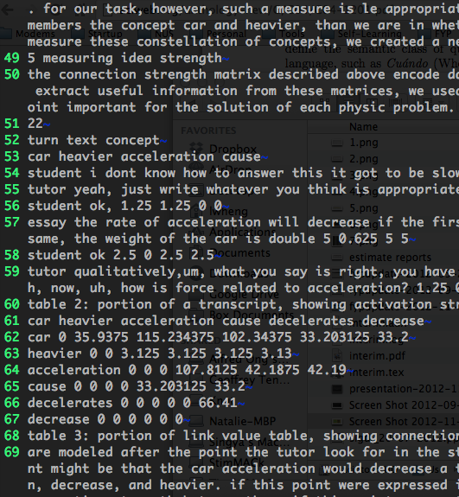
Collecting Annotation – 1st Attempt
Citing Context
Citing
Cited

Slide 50
Collecting Annotation – 1st Attempt
After a trial round of annotation:
Annotation task is difficult
Need to understand content; Need research experience
Annotation scheme is too tricky
Annotating by line number is bad idea. Difficult to judge correctness; not discrete
Annotation: L12-55
Prediction: L50-78
Overlap? Yes
Correct? ???

Slide 51
Collecting Annotation – 1st Attempt
Annotations do not agree among annotators
Example:
W98-1241==>W97-1011,276-285!502-518
W98-1241==>W97-1011,General
W98-1241==>W97-1011,74-97

Slide 52
Collecting Annotation – 2nd Attempt
Annotate by fragments. Use ParsCit [Councill et al, 2008] for parse cited paper into logical structures
For each citation, for each context, for each fragment, annotate with labels:
General (g)
Specific-Yes (y)
Specific-No (n)
Only one annotator – myself.

Slide 53
Collecting Annotation – 2nd Attempt
:
Fragment 1
Fragment 2
Citing Context
Fragment 3
Fragment i
:
Fragment m
Citing
Cited

Slide 54
Example
Citing
Cited
…learning algorithm used on our experiments. 3.1 Using Internet As Kilgarriff and Grefenstette wrote, the Internet is a fabulous linguists’ playground (Kilgarriff and Grefenstette, 2003). It has become the greatest information source available worldwide, an…
The Web, teeming as it is with language data, of all manner of varieties and languages, in vast quantity and freely available, is a fabulous linguists’ playground. This special issue of Computational Linguistics explores ways in which this dream is being explored.

Slide 55
Example
Citing
Cited
…than for English and Spanish. Estimates reported in (Kilgarriff and Grefenstette, 2003) show that for Italian the web size in words is 1,845,026,000; while for English and Spanish the web sizes are 76,598,718,000 and 2,658,631,000 respectively. Thus our method…
…ese 1,333,664,000 Estonian 98,066,000 Italian 1,845,026,000 Slovenian 119,153,000 Spanish 2,658,631,000 Croatian 136,073,000 French 3,836,874,000 Malay 157,241,000 German 7,035,850,000 Turkish 187,356,000 English 76,598,718,000

Slide 56
Collecting Annotation – 2nd Attempt
Item | Statistics
No. of Cite Links | 275 (7.6% Specific)
No. of Fragments | 30943 (0.09% Specific-Yes, 12.9% Specific-No)

Slide 57
Collecting Annotation – 2nd Attempt
Specific citations can be categorized into 4 sub-classes:
To refer to digits/numerical figures
To refer to term definitions
To refer to algorithm/theorem
To quote
(For this corpus only)

Slide 58
Outline
Introduction
Related Work
Problem Analysis
Approach
Evaluation
Discussion & Conclusion

Slide 59
Approach

Slide 60
Two-tier Approach
General
Predict
Cite Link
Contexts
Specific
First Tier
Second Tier
Predict
Specific Context
Citing-Cited Pairs
Provenance found

Slide 61
GvS (1st tier)
Item | Statistics
No. of Cite Links | 275 (7.6% Specific)
No. of Fragments | 30943 (0.09% Specific-Yes, 12.9% Specific-No)

Slide 62
GvS (1st tier)
From annotations, this task is heavily skewed towards General citations (7.6% of Specific)
Filter out General citations, keep Specific citations
2-class citation classification task
Extract information from citing paper : citing sentence and citing context

Slide 63
Building GvS Model
A model built on skewed data would be biased
To address this problem, build model on artificially sample unskewed data.
1:1 General vs Specific instances
Gather all Specific + randomly select same # of General
Appear unrealistic to use this ratio
We are building a model with balanced data to measure its ability to differentiate between the 2 types of citation

Slide 64
GvS Features
Physical Features [Dong & Schaffer, 2011]
Location – section where citing sentence is from
Popularity - # of citation marks in citing sentence
Density - # of unique citation marks in citing sentence and neighbor sentences
AvgDens – average of Density among citing and neighbor sentences
Intuition: From our observations, citations in Evaluation section usually cite results from the same section in the cited paper. Thus location would suggest the type of citation. Also, General citations tend to have high # of citation marks within the sentences

Slide 65
GvS Features
Number Density (New)
Density of numerical figures in citing context
Intuition: Specific citations tend to refer to numerical figures
Published Year Difference (New)
Large publishing time gap; Long term citations are usually for General purposes

Slide 66
GvS Features
Citing Context’s Average TFxIDF weight (New)
Average number of valuable words determined by TFxIDF. Higher values suggest important, signature words pertinent to a specific claim. Thus, suggests a Specific citation
Cue Words [Dong & Schaffer, 2011]
Count of specific cue words that appear in citing and neighbor sentences
Cue-General and Cue-Specifi

Slide 67
Cue-General (31)
proposed, propose, presented, present, suggested, suggests, described, describe, discuss, discussed, gave, introduction, introduced, shown, showed, sketched, sketch, talked, adopted, adopt, based, originated, originate, built, researchers, comparative, comparison, following, previously, previous
Cue-Specific (21)
obtains, obtained, score, scored, high, F-score, Precision, precision, Recall, recall, estimated, estimates, reported, reports, probability, probabilities, peaked, experimental, experimented, rate, error

Slide 68
Two-tier Approach
General
Predict
Cite Link
Contexts
Specific
First Tier
Second Tier
Predict
Specific Context
Citing-Cited Pairs
Provenance found

Slide 69
LocateProv (2nd tier)
Item | Statistics
No. of Cite Links | 275 (7.6% Specific)
No. of Fragments | 30943 (0.09% Specific-Yes, 12.9% Specific-No)

Slide 70
LocateProv (2nd tier)
Ratio of fragments ≈ 1:1000 (Specific-Yes : Specific-No + General)
Extremely skewed against Specific-Yes
Ratio of fragments ≈ 1:100 (Specific-Yes : Specific-No)
Thus, input to LocateProv are Specific citations only
Binary classification on fragments
To predict Specific-Yes or Specific-No

Slide 71
Building LocateProv Model
Similar strategy as GvS
Skewed data
Artificially sample unskewed data
1:1 Specific-Yes vs Specific-No instances

Slide 72
LocateProv Features
Surface Matching (New)
Amount of word overlap between the citing sentence and a fragment in the cited paper
Number Near-Miss (New)
Amount of numerical figures overlap between citing sentence and a fragment in the cited paper
Rounding numbers / Converting to percentage
Rounding: 81.06 → 81.1
Covert to %: 0.87 → 87%
Based on observations: citations may refer to evaluation results in cited paper

Slide 73
LocateProv Features
Bigram Matching (New)
Bigram: every sequence of 2 adjacent words
Percentage of bigrams overlap between citing sentence and a fragment in the cited paper
Word order
Term definition and quote
Cosine Similarity
Model citing sentence and fragment into vectors in a n-dimensional space
Similarity between the 2 vectors, A and B

Slide 74
Outline
Introduction
Related Work
Problem Analysis
Approach
Evaluation
Discussion & Conclusion

Slide 75
Evaluation

Slide 76
Evaluating GvS
Leave-One-Out strategy
Test on one instance, train model on the rest
Maximize instances for training
Compare performance on various classifiers
Balanced performance

Slide 77
Evaluating GvS
Class / Values | SVM |  |  | NB |  |  | DT
 | P | R | F | P | R | F | P | R | F
General | 0.76 | 0.79 | 0.77 | 0.64 | 0.82 | 0.72 | 0.67 | 0.64 | 0.65
Specific | 0.78 | 0.75 | 0.76 | 0.75 | 0.54 | 0.63 | 0.66 | 0.68 | 0.67
Leave-One-Out for GvS
 | Actual g | Actual s
Predicted g | 22 | 6
Predicted s | 7 | 21
Confusion Matrix for SVM (Leave-One-Out for GvS)

Slide 78
Evaluating GvS
Vary amount of training data
Measure performance with less training data
Increasing performance
Potential to be used in practice if provided large enough dataset

Slide 79
Evaluating GvS
Evaluate discriminative power of features using SVM
Configuration | Accuracy
Full | 0.911
Full - A | 0.714
Full - B | 0.875
Full - C | 0.786
Full - D | 0.911
Full - E | 0.732
Configuration | Accuracy
Only A | 0.696
Only B | 0.589
Only C | 0.625
Only D | 0.535
Only E | 0.696
A – Physical Feature; B – Number Density; C – Published Year; D – Avg TFxIDF E – Cue Words

Slide 80
Evaluating GvS
Balanced performance on various classifiers
An increasing performance when given more training data
Potential to be used in practice
Most important feature – Physical Features

Slide 81
Evaluating LocateProv
Leave-One-Out
Balanced performance
Class / Values | SVM |  |  | NB |  |  | DT
 | P | R | F | P | R | F | P | R | F
Specific-No | 0.92 | 0.82 | 0.87 | 0.84 | 0.96 | 0.90 | 0.89 | 0.89 | 0.89
Specific-Yes | 0.84 | 0.93 | 0.88 | 0.96 | 0.82 | 0.88 | 0.89 | 0.89 | 0.89
Leave-One-Out on LocateProv
 | Actual n | Actual y
Predicted n | 27 | 1
Predicted y | 5 | 23
Confusion Matrix for NB (Leave-One-Out on LocateProv)

Slide 82
Evaluating LocateProv
Evaluate discriminative power of features
Configuration | Accuracy
Full | 0.893
Full - F | 0.893
Full - G | 0.875
Full - H | 0.893
Full - I | 0.786
Configuration | Accuracy
Only F | 0.714
Only G | 0.625
Only H | 0.607
Only I | 0.875
F – Surface Matching; G – Number Near-Miss; H – Bigram; I – Cosine Sim

Slide 83
Evaluating LocateProv
Compare with a baseline
Baseline: Only Cosine Sim (Feature I)
Sampled an unskewed dataset
Train on 75%, Test on 25%
Class / Values | LocateProv |  |  | Baseline
 | P | R | F | P | R | F
Specific-No | 0.86 | 0.86 | 0.86 | 0.75 | 0.60 | 0.67
Specific-Yes | 0.86 | 0.86 | 0.86 | 0.80 | 0.89 | 0.84

Slide 84
Evaluating LocateProv
Balanced performance on various classifiers
Most important feature – Cosine Similarity
Performed slightly better than baseline

Slide 85
Outline
Introduction
Related Work
Problem Analysis
Approach
Evaluation
Discussion & Conclusion

Slide 86
Discussion
Challenge: Only 7.6% Specific, only 0.09% Specific-Yes
LocateProv: Performance slightly better than baseline. As a search it is, there’s room for improvement
Features not yet good enough for this task
Explore more alternatives, e.g., paraphrasing
Citation Provenance
A combination of 2 mechanisms: Citation Classification and Search
Is it worth it to work on Citation Provenance?
Yes. An important reading tool to understand and navigate between papers
Supporting evidence: CitWeb; CodeForScience2012

Slide 87
Conclusion
New task in citation analysis, Citation Provenance
First attempt to provide a solution to the challenge of locating the origin of a citation
2-tier approach
GvS and LocateProv
Filter and Search
Task is heavily skewed
Artificially create unskewed data
Train model on unskewed data
Evaluations showed promising results

Slide 88
Thank You

